Slide 1
Simplified Data Quality Monitoring
of Dynamic Longitudinal Data
R Ladies NYC
November 2019
A Functional Programming Approach
Jacqueline Gutman, M.S.
Flatiron Health
Quantitative Sciences
Notes:
Hi, I’m Jackie Gutman, and I’m going to talk a little about an approach to data science programming we use at Flatiron Health to help us continuously monitor data quality in oncology healthcare data

Slide 2
Outline
Introduction to Flatiron
Our data quality problem + how we handle it
What is functional programming + how is it relevant in data science?
5 key benefits of functional approaches to data science
  Readability
  Compositionality
  Reproducibility
  Robustness
  Efficiency
Notes:
So I’ll quickly introduce myself and the challenge we’ve been addressing in maintaining very high standards for data quality in datasets that are continually being updated, refreshed, and redelivered each month. And then I’ll show how some approaches to structuring the data and taking a functional approach to code development helps mitigate and simplify that challenge

Slide 3

Jacqueline Gutman
Data Scientist, Flatiron Health
Jackie %>%
learn( Psych + Machine Learning)%>%
study( NYU Center for Data Science)%>%
intern( Data Science for Social Good)%>%
work( NYU School of Medicine)%>%
work( Plated/Albertsons)%>%
work( Flatiron Health)
Notes:
First, a little bit about me: I joined Flatiron Health in January after doing data science and machine learning in a couple of different industries, including medical education, public school education, and meal kit delivery services, and now I do the same for oncology and clinical care.

Slide 4

To improve lives by learning
from the experience of
every cancer patient.
OUR MISSION
Notes:
Flatiron Health is a company that strives to improve lives by learning from the experience of every cancer patient. Practically speaking, that means a lot of data, including data on over 2 million cancer patients in the United States.
That data gets updated on a continual basis and we freeze and then deliver that data to partners and clients every month with a 30 day recency, meaning that the time from a patient experience or outcome being observed in the electronic health record to the time that observation is in the hands of researchers and industry leaders who can generate insights from it is only 1 month, which is unparalleled in the world of medical research and real world evidence.

Slide 5

Founded
2012
Employees
~900 full-time employees
1,000+ part-time abstractors
Clinicians
12 medical oncologists
85+ total clinicians
Technical
staff
350+ in software, IT,
security, data insights &
medical informatics
Quantitative
scientists
~50 biostatisticians, epidemiologists
& data scientists
Offices
New York (HQ)
San Francisco
Notes:
Something that will become very relevant to our data quality approach is that our company relies on close collaboration between technical staff with expertise in building, managing, and testing data pipelines, statistical and methodological experts who love to dig into and evaluate the data, and clinical experts in oncology who help us translate what we’re seeing in the data to what that means for the patients with cancer and oncology providers described by the data.

Slide 6
Over 2.2
million
patient records available for research.
Over 15 of
the top
oncology-pharma companies are members of our research network.
800 sites of care
use Flatiron’s OncoCloud™ software.
7 academic centers
partner with Flatiron on outcomes research and quality improvement.
Notes:
Our data points come to us from a wide array of sources, including the more than 800 unique sites of care that use our electronic health record technology as well as several academic medical centers each using their own electronic health record software, and they partner with us on converting their data into outcomes research.

Slide 7
National, longitudinal real-world datasets refreshed monthly, with 30-day recency
Acute Myeloid Leukemia
Advanced Head & Neck Cancer
Advanced Gastric Cancer
Advanced Melanoma
Advanced Non-Small Cell Lung Cancer
Advanced Urothelial Carcinoma
Chronic Lymphocytic Leukemia
Diffuse Large B-Cell Lymphoma
Early Breast Cancer
Hepatocellular Carcinoma
Mesothelioma
Metastatic Breast Cancer
Metastatic Colorectal Cancer
Metastatic Pancreatic Cancer
Metastatic Prostate Cancer
Metastatic Renal Cell Carcinoma
Multiple Myeloma
Ovarian Cancer
Small Cell Lung Cancer
Follicular Lymphoma
Notes:
One of our major products are these national, longitudinal datasets of real world oncology data, which we update and grow each month. We currently deliver datasets on 20 distinct cancer types.
These datasets have some shared but non-identical data structures, and part of monitoring the quality of our data over time includes tracking the changes to our data delivery this month as compared to the month before, or 3 months before, or 6 months before, and understanding the quality and consistency of the data for each type of cancer as compared to other data marts we’ve built out and continue to maintain and grow each month.

Slide 8
Our challenge:
Identify issues of data quality in dynamic longitudinal data
What this entails
New data elements collected and integrated each month from disparate sources
Ensure quality by monitoring unusual changes within and across variables + patients
Raise actionable and interpretable alerts when changes fall outside accepted bounds
Harness methodological and statistical expertise with domain-specific clinical intuition to reason about many datasets simultaneously
Notes:
What this means for us, is that we need a framework for detecting and monitoring unusual changes within and across variables, within and across cancer types, and within and across patients between snapshots of our data frozen at distinct points in time. We need to be able to stand up that quality framework on a regular ongoing basis, as the number of data elements within each dataset, as well as the number of unique datasets overall, continue to increase at a rapid pace.
In addition to that, we need to have reliable, readable code that can be collaboratively developed by technical and non-technical and clinical staff to synthesize methodological best practices with clinical intuition.
There are many frameworks and tools that go into this, but I want to specifically focus on a few perspective shifts that make this comparative evaluation of our data possible, in a maintainable and scalable way.

Slide 9
How we approach our problem
OBJECTIVES
Codify statistical and domain knowledge in a library of composable, modular functions
Decouple the high-level checks and reasoning from the low-level implementation details
Extend reasoning about a single dataset to apply across an expanding number of datasets
BENEFITS
Reproducible and documented best practices are easily shared
Abstraction reduces the cognitive complexity of an analysis and makes reasoning more transparent
Easier to scale analysis not just within a dataset, but as the number of datasets and elements increase
Notes:
In order to meet this challenge, we knew we would benefit from codifying that statistical and domain knowledge into a library of modular functions, and that those functions should be testable, clear in intent, and able to be composed into higher-level more abstract processes.
Building out those function libraries served to document and enforce what we on the Quantitative Sciences team had established as the best practices for working with our data.
Additionally, for the purposes of maintainability, and fostering collaboration, we wanted to decouple the high-level checks and reasoning from the low-level implementation details, to make those checks more transparent and interpretable.
And finally we wanted to ensure a flexible approach that could take reasoning and code originally developed for working with a single dataset, and seamlessly extend to analyzing many datasets simultaneously, without breaking down when the structure of a new dataset differed in minor but meaningful ways from historical data or data derived from a different cancer type or patient population.

Slide 10
Core principles of functional programming
Functions!
that can be composed into higher-order functions (compositionality)
which abstract out what is being done (declarative) from how it will be carried out (imperative)
and which avoid side-effects and external state dependencies (immutability)
Notes:
So, the way we approach this problem borrows a lot from the principles of functional programming, and it’s easy for discussions of functional programming to quickly devolve into computer science jargon but for our purposes in data science and data quality in particular that definition really means a few key things.
>> Most importantly--functions, lots of functions, and functions as first-class citizens that we can treat as any other variable and pass as inputs to other functions,
first-class functions, functions that behave like any other data structure. In R, this means that you can do many of the things with a function that you can do with a vector: you can assign them to variables, store them in lists, pass them as arguments to other functions, create them inside functions, and even return them as the result of a function.
>> which allows us to string these functions together into higher order functions that return other functions depending on the conditions and context of how we’re using them.
>> Thirdly, that these functions, or chains of functions, with their very clear declarative names, give us some additional degrees of separation from the mechanics of the implementation, to allow us to abstract out what is being done from precisely how that process will be carried out.
>> And finally, that these functions strive for some degree of purity, in that they avoid side effects and dependencies on variables and states outside of the world of the function. That gives us a sense of confidence that no matter what else is in our environment, no matter what order we run the function in or how many times we call it, if we provide the same input we can expect to get the same output out of it.

Slide 11
Building blocks of our approach to data quality
Conceptual code review
NESTED DATA STRUCTURES
DataFrames for your DataFrames!
LIBRARY DEVELOPMENT
Promote visibility, unit testing and
documentation for your functions
DIFFERENTIATED CODE REVIEW
For technical and non-technical
project team members
PROBLEM / DOMAIN
EXPERTISE
TECHNICAL EXPERTISE
Implementation code
review
Notes:
>> One thing that’s a little bit different about our approach to measuring data quality is that we’re often working with many datasets at once, whether that means this month’s data as compared to the data frozen at the end of last month, the data for advanced non-small cell lung cancer as compared to the data for metastatic breast cancer, or the data around sequences of therapy as compared to our biomarker testing data.
The way we define quality measures is often relative to something else, and so nested data structures, where we may have a Pandas DataFrame where one column is made up of other DataFrames or is made up of connections to a SQL database is a useful simplifying framework that helps analysts and data scientists transition from working with an reasoning about a single dataset, to reasoning about many datasets at once.
Secondly, emphasizing library development rather than standalone analyses helps us support not just code reusability, but also create a data science culture that promotes visibility of code between siloed teams, and encourages the development of unit testing and function documentation.
And finally, this functional approach really empowers a kind of differentiated code review. >> When we talk about code review, we often think exclusively about software engineers, and sometimes data scientists, checking the implementation of a particular piece of code.
>> But on our cross-functional teams, we also want to ensure that those closest to the intention are reviewing whether the approach we are taking is reasonable, and not just whether it is implemented correctly. So this style of programming supports a team structure where those with significant problem and domain expertise can undertake a conceptual code review, and those with considerable technical expertise can focus on an implementation code review.

Slide 12
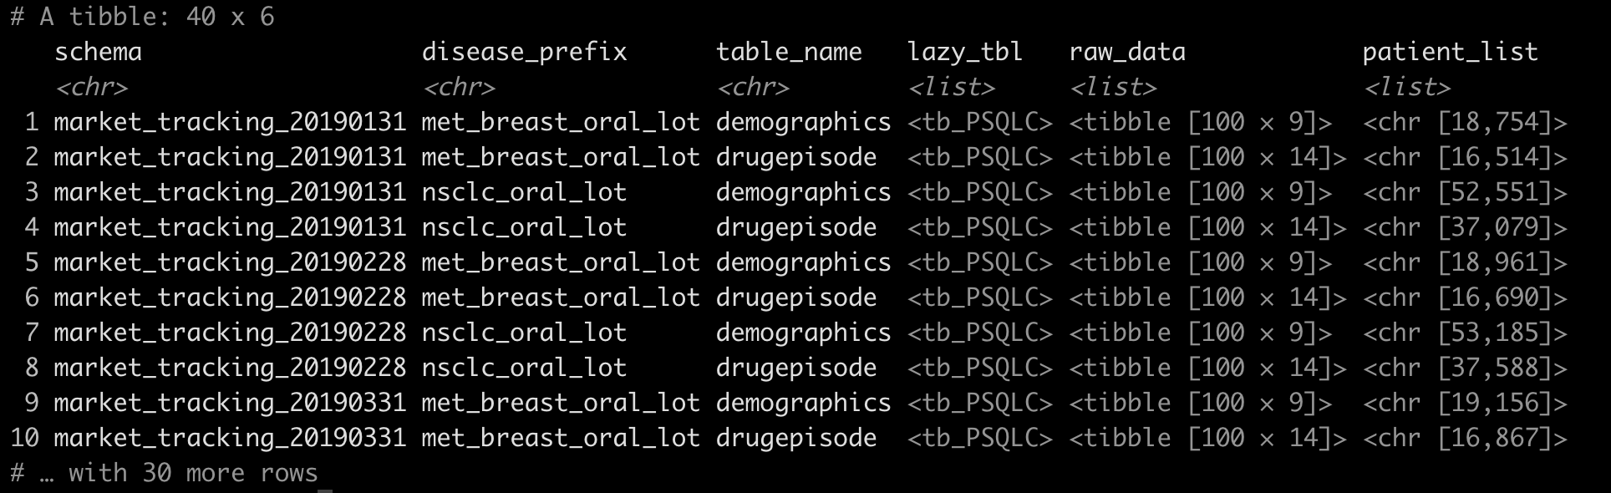
Store tibbles, lists, and in-database lazy tbls
as columns in a nested data_frame
Data + metadata + evaluation metrics + summary statistics = FRIENDS FOREVER

Slide 13
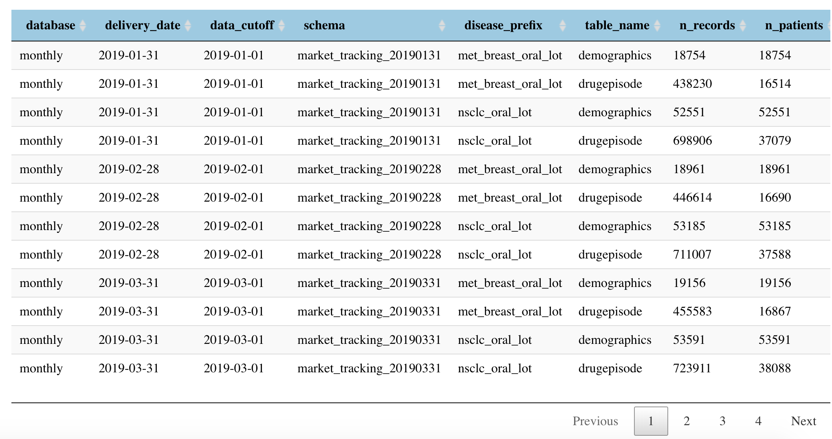
Nested data structures
for comparing and evaluating multiple datasets
Treat individual datasets as single observations
Simple function:
1 dataset → 1 evaluation metric
Higher order functions:
Multiple datasets → composite evaluation metrics across several dimensions
Notes:
So I just spoke about these nested data structures. We can build out a dataframe that refers to several frozen snapshots taken at different points in time, from different database schemas and tables, about different disease types.
>> And because dataframes are the fundamental unit we are used to working with, we can now treat individual datasets as we would single observations, and databases of many datasets with associated metadata as a typical dataset that we wish to understand and analyze.
We can take those simple functions and processes we developed to take in a single dataset, and produce a single evaluation metric, and create higher order functions that return composite evaluation metrics across many dimensions and datasets.

Slide 14
Nested data structures
for comparing and evaluating multiple datasets
count_records <- purrr::partial(execute_query,
select = "COUNT(*)")
count_patients <- purrr::partial(execute_query,
select = "COUNT(distinct patientid)")
fetch_patients = purrr::partial(execute_query,
select = "DISTINCT patientid",
limit = 100)
data %<>%
mutate(n_records = purrr::map(lazy_tbl, count_records, con = conn),
n_patients = purrr::map(lazy_tbl, count_patients, con = conn),
cohort = purrr::map(lazy_tbl, fetch_patients, con = conn))
Notes:
Here for example, we can take a very broad and generic function to execute a query, use partial functions to fill in some of the arguments to that function to make it do something more specific, like execute a query against the database that counts all unique patients in a dataset, or execute a query against the database to return a list of all patients meeting a specific inclusion criterion, and we can apply that function to all nested datasets within our parent dataframe, which for a sense of scale may contain dozens of datasets, each perhaps with tens of thousands of observations.
Moreover, starting from this structure, we can add complexity by chaining some of these functions together into larger pipelines, or building in a kind of error handling to these component functions, but the functions themselves remain easy to develop because each function still takes in either a single dataset, or a pair of datasets to be compared.

Slide 15
What does all this get you?
Readability
Compositionality
Reproducibility
Robustness
Efficiency
Notes:
I’m going to go through some more concrete examples of what this kind of approach to programming for data quality can get you, but we’ve found the benefits can really be broken down into these 5 dimensions.

Slide 16
Readability
Abstraction and Declarative intent
Analysis code can be understood and sanity-checked by non-technical staff
Clarity of intent: abstract declarative code is self-documenting
Docstrings and unit tests to align implementation with intention
compare_snapshots(
january_data,
february_data,
fn = compute_time_to_dx)
find_added_patients(
old_data =
january_data$cohort,
new_data =
february_data$cohort)
Notes:
First and foremost, this approach really lends itself to readable code. Higher level abstractions that emphasize declarative intent over procedural instructions are more easily understood and sanity checked by non-technical staff, which supports the kind of differentiated code review we spoke about earlier.
This also provides a kind of self-documenting code, where the function and variable names themselves describe what is being done. The actual function design then becomes a process where implementation is aligned with intention.

Slide 17
Compositionality
Reasoning with higher level functions
filter_persistent_patients <-
function(data) {
…
}
compute_change_from_prev <-
function(data, var, prev_var) {
…
}
summarize_change_distribution <-
function(data, change_var) {
…
}
process_drug_episodes <- . %>%
filter_persistent_patients %>%
compute_change_from_prev(
var = “num_drug_episodes”,
prev_var = “prev_drug_episodes”) %>%
summarize_change_distribution(
change_var = “change_num_drug_episodes”)
data_processed <- process_drug_episodes(data)
Notes:
Next, another advantage we see is compositionality, which allows us to string together simpler functions into higher level functions of increasing complexity without compromising flexibility, readability, or testability.
We’re all familiar with the magrittr pipe, and how we can use the pipe to compose functions into a pipeline of transformations or operations, and we can save that as a functional sequence if we want to apply it consistently over multiple datasets.

Slide 18
Compositionality
Reasoning with higher level functions
lm(Sepal.Length ~ Species,
data = iris) %>%
broom::tidy(
conf.int = TRUE) %>%
filter(p.value < 0.05) %>%
arrange(desc(statistic))
tidy_lm <- purrr::compose(
lm,
~ broom::tidy(.x,
conf.int = TRUE),
~ filter(.x,
p.value < 0.05),
~ arrange(.x,
desc(statistic)),
.dir = “forward”)
tidy_lm(Sepal.Length ~ Species,
data = iris)
Notes:
We can take a similar approach with other functions using the compose function in purrr library.
Now, instead of having to repeat the pipe again and again with different inputs, we can compose that into a new succinctly and appropriately named functional sequence for a really interpretable workflow.

Slide 19
Compositionality
Reasoning with higher level functions
cohort %<>%
left_join(demographics) %>%
left_join(mortality) %>%
left_join(drugepisode) %>%
left_join(progression)
tbls <- list(demographics,
mortality,
drugepisode,
progression)
cohort %>%
purrr::reduce(tbls,
left_join, .init = .) ->
cohort_plus
With a nested data frame:
all_data %>%
mutate(cohort_plus =
reduce(list(demographics,
mortality,
drugepisode,
progression),
.f = left_join,
.init = cohort))
Notes:
We can take a similar approach with other functions using the compose function in purrr library.
Now, instead of having to repeat the pipe again and again with different inputs, we can compose that into a new succinctly and appropriately named functional sequence for a really interpretable workflow.

Slide 20
Reproducibility
Avoiding side effects and external states
Running the same function with the same input should always produce the same result
Safeguard reproducibility with
  Immutable inputs + outputs
  Idempotent processes
  Deterministic algorithms
But sometimes we need side effects!
Printing
Plotting
Saving output to disk
Notes:
Another important advantage here is reproducibility. We want to have confidence that for any analysis, running the same function with the same input should always produce the same result. By developing functions where we avoid mutability, where calling the function changes the actual state or variables defined outside of the function, and preventing other kinds of side effects, we can avoid hard to test for bugs, where the successful or failure of a unit test depends on things outside of the actual function and input itself--like what else existed in the global environment when the function was called, the number of times the function was run, or other external dependencies.

Slide 21
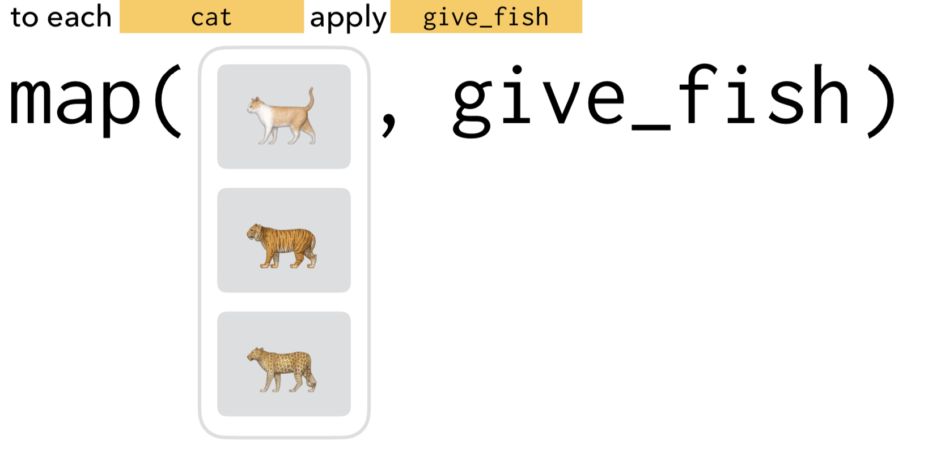
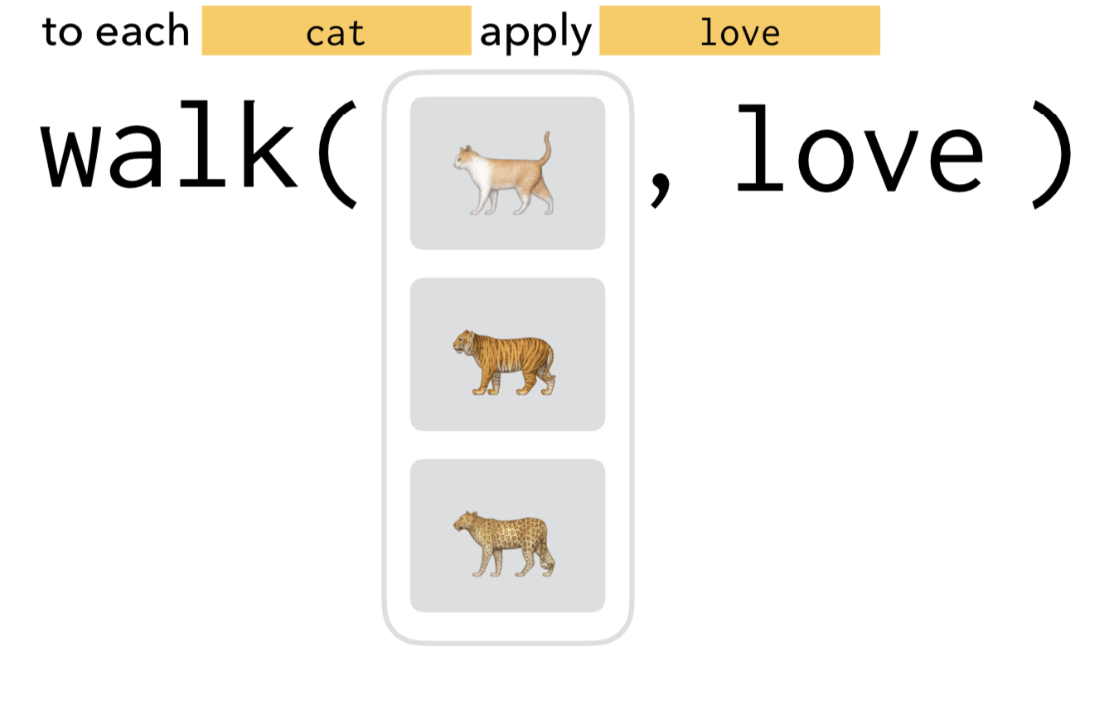
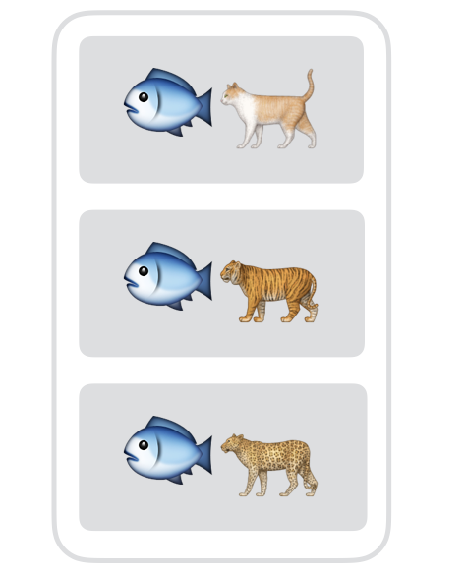
Reproducibility
Clearly separate pure functions from functions desired for their side effects
O
U
T
P
U
T
Side effects
No side effects!
Notes:
It can be helpful to really distinguish between functions that are pure and have no side effects, from those that are intended primarily for their side effects. Keep them separate in development, and document their intended use clearly, and use purrr’s map vs walk to distinguish between the use of pure and impure functions in an analysis

Slide 22
Robustness
Testability and elegant error handling
Functional modular code makes for happy unit testing
  Avoid difficult to test code stemming from Mutability, Side-Effects, Responsibility overload, and Procedural instructions
Avoid side effects and maintain your functional flow
  try-catch exception blocks can be refactored as higher order functions
error_prone_fn <- function(data) {
...
}
safe_fn <- purrr::safely(
.f = error_prone_fn,
otherwise = c())
data %>%
mutate(results = purrr::map(
input, safe_fn))
Notes:
Closely related to this is the idea of robustness--modular, functional code that avoids mutability, side effects, and dependencies on external states is easier to test, and using unit testing effectively means more robust code in the long run. Code that is harder to test will be less effectively tested, and more prone to unexpected errors.
>> But what about expected errors? The functional approach can help here too, by wrapping unsafe brittle functions with no exception handling in their own try-catch exception handlers, where the exception handled function can be returned as just another, more robust function, and that robust function can be mindlessly deployed in an analysis without breaking the functional flow of the code or thinking about the potential exceptions that might occur. The toolz library provides us this wrapper to turn any callable into a more robust version with its own bottom value, thus avoiding side effects of exception throwing in the process.

Slide 23

Efficiency
Laziness and caching
parse_dateofdeath_chunked <- purrr::partial(do,
data_modified = mutate(., dateofdeath = parse_dod(a, b, c)),
.chunk_size = 1000L)
parse_dateofdeath_chunked(mortality)
Dbplyr backend for databases
Dtplyr backend for data.tables
Notes:
Finally, for this particular use case we’re often much less concerned about gains in efficiency, especially if that comes at the cost of things like readability, reliability, and robustness. But even so, there are ways to take advantage of lazy evaluation and caching of previously computed values that can provide improvements in efficiency too.
purrr::map is built around a principle of lazy, just in time evaluation

Slide 24
Efficiency
Laziness and caching
Use when evaluating a function repeatedly over the rows (or larger chunks) of a dataset, and expect to regularly get the same input
Performance gains depend on how often a function is being called with same argument(s)
compute_biomarker_status <- function(
biomarker_results){
…
}
compute_biomarker_status_cached <-
memoise::memoise(compute_biomarker_status)
data %<>%
mutate(biomarker_status =
purrr::map(biomarker_results,
compute_biomarker_status_cached)
Notes:
Additionally, if we expect that over the course of an analysis a function may be called several times with the same inputs, and that function execution is itself expensive, we can save some computation by caching or memoizing the results in a hashable dictionary, which we’ll hit up on subsequent function calls, and only compute the result if it cannot be found in the cache. So since we’ve designed our functions in such a way that they should always return the same output when given the same input, we can avoid duplication of effort by recomputing the results for common inputs, and we can decide how many recently returned results we want to store in memory.

Slide 25


Thanks!
flatiron.com/blog/
@jgutman
@dynamicdataduo
Notes:
Thanks! That’s it. You can find more information about what we do at Flatiron and what kind of data products we build on our blog.

